Slide 1
Data Science
General Notes
Giuseppe Giametta
Data Scientist

Slide 2
Table of Contents
Statistics
Machine Learning Fundamentals
Scrum
Jupyter Notebook
Data Visualization
Rstudio
Time Series Forecasting
LSTM
Transformers
Gradient Boosting Methods
GB
XGBoost
LightGBM
NLP

Slide 3
SQL

Slide 4
What is SQL?
Structured Query language is a standard computer language for relational database and data manipulation.
Non-procedural language
You cannot write complete applications with it
It is used for:
read/retrieve data
Write data
Update data

Slide 5
Database Administrator vs. Data Scientist
A DBA is in charge of:
Managing database
Giving permission to users
Manage and create table
Give access to data
Use SQL to retrieve data
A data scientist:
Is the end user of the db
Use sql to retrieve data
Create their own table for testing
Combine multiple sources
Write complex queries to analysis

Slide 6
What is data modelling?
Data modelling consists in a way to organize multiple information into tables.
It usually represents a business process.
A data model is a way to represent tables in a database.

Slide 7
A Relational database is designed to show relationships between its tables (useful to optimize queries).
A transactional database is a database management system (DBMS) that can reverse or scale back a database transaction or activity if it isn’t performed correctly.
The building blocks of a DB are:
Entity - a person, place, thing or event
Attributes - characteristics of an entity
Relationship - describe association between entities
One-to-one
One-to-many
many-to-many

Slide 8
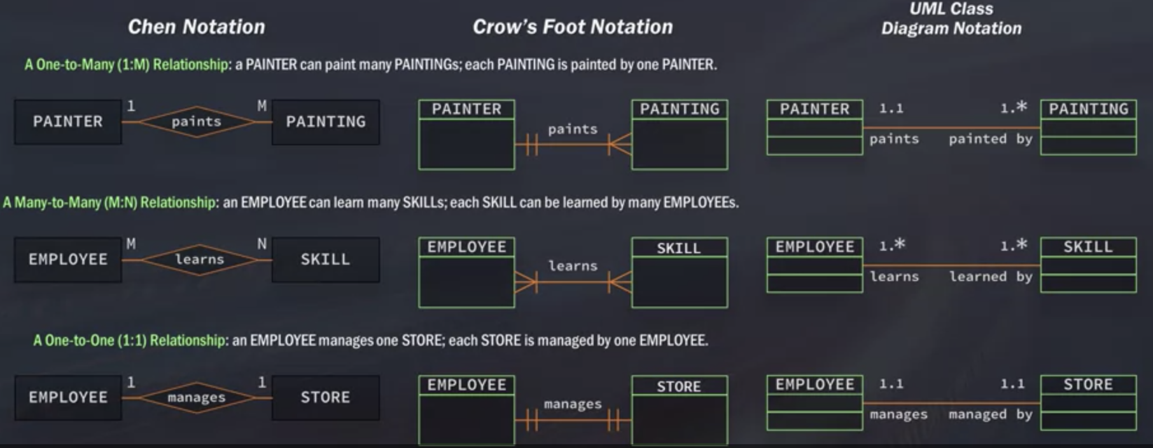
ER model
ER models are used to display entities with their attributes and their relationships.
It helps to understand and visualize a business process.
The relationship between entities can be expressed with different notations:

Slide 9
Primary Keys and Foreign Keys
The primary key (PK) is a column or a set of columns which uniquely identifies each row of the table.

Slide 10
SELECT statement
SELECT product_name
FROM products
LIMIT n_rows
You can use asterisk to select all columns
Table from which retrieve the data
Limit the number of rows to show

Slide 11
Create tables
CREATE TABLE Persons (
PersonID int PRIMARY KEY,
LastName varchar(255) NOT NULL,
FirstName varchar(255) NOT NULL,
Address varchar(255) NOT NULL,
City varchar(255) NOT NULL,
Gender varchar(255) NULL
);

Slide 12
Adding data to the table
INSERT INTO Person
(Id,
Name,
Surname,
address
)
VALUES(‘1234’,
‘Joe’,
‘Joe’,
‘764 loar road’
)
The values will follow the columns’ order

Slide 13
Create temporary table
Temporary tables are valid within the scope of the current session. They are faster to create and useful when we have to make complex queries and joins.
CREATE TEMPORARY TABLE Sandals as (
SELECT *
FROM Shoes
WHERE shoe_type = ‘sandals’
)

Slide 14
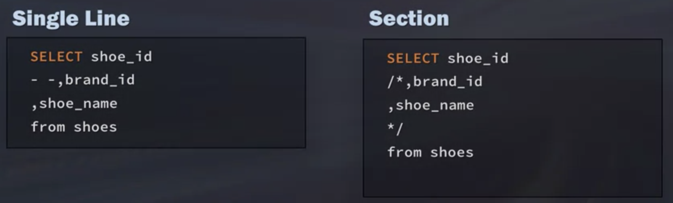
Adding comments

Slide 15
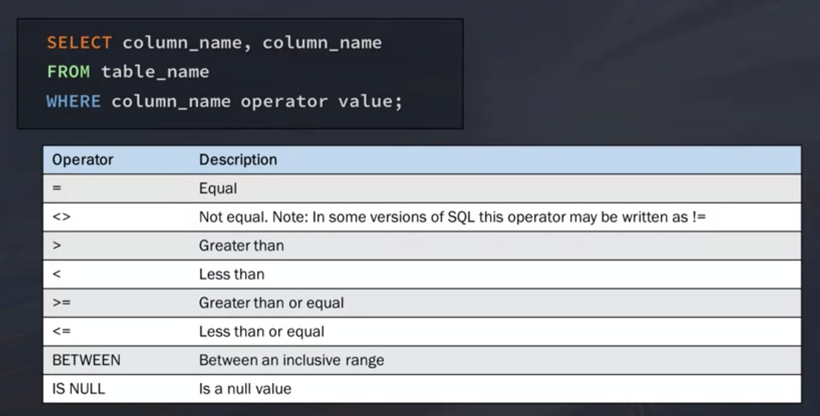
WHERE Clause

Slide 16
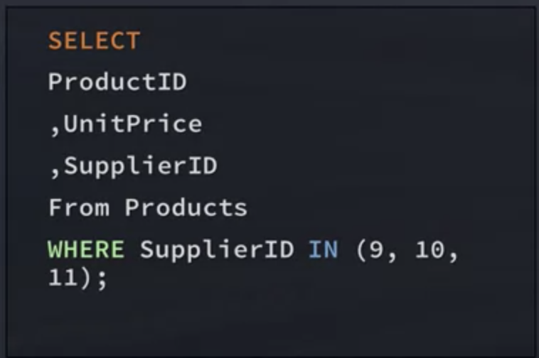
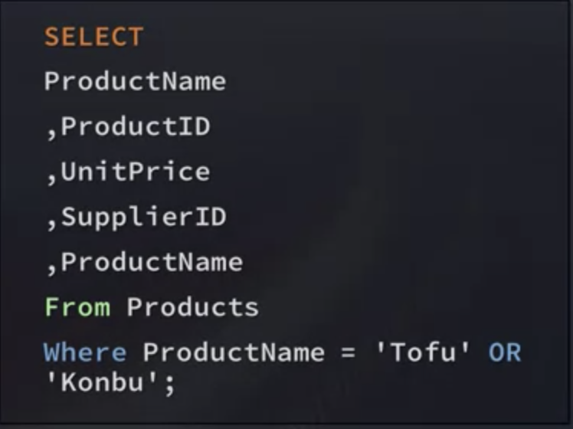
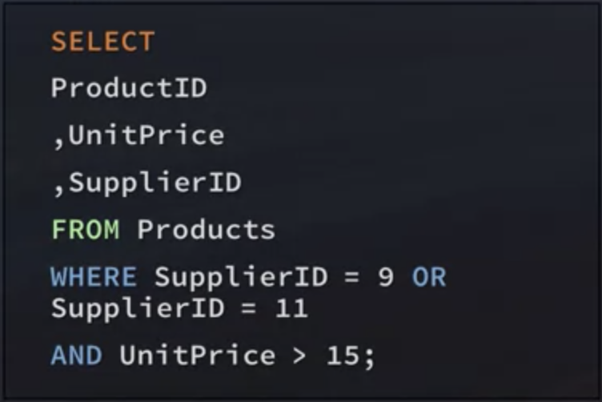
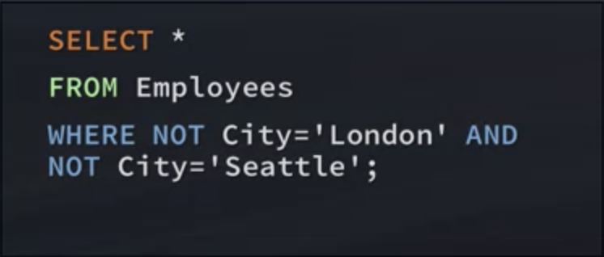
FILTERING with IN, OR and NOT
By default, SQL processes AND before OR.
To avoid that, use ()
IN executes faster than OR
Can contain SELECT
DBMS will not evaluate the second condition if the first one is met

Slide 17
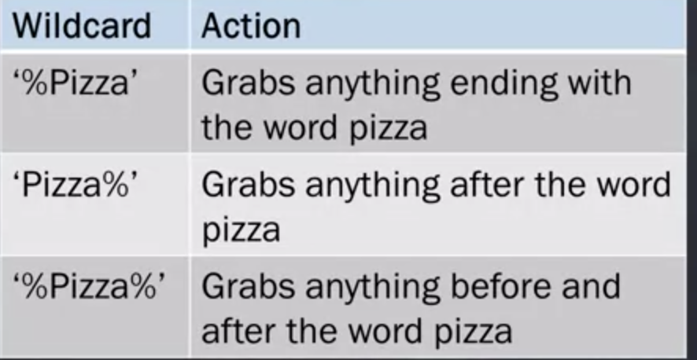
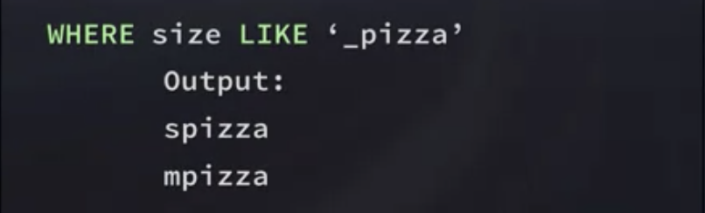
Wildcards
Used to find patterns
They don’t match NULL
Can only be used with strings
Match a single character

Slide 18
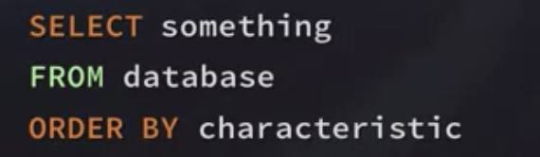
ORDER BY Clause
Can take multiple column names
Can sort by column not retrieved
You can order by column position

Slide 19
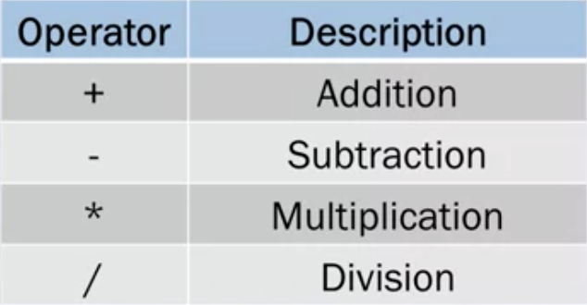
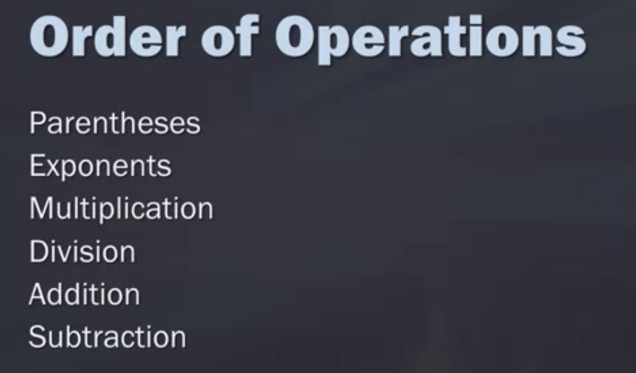
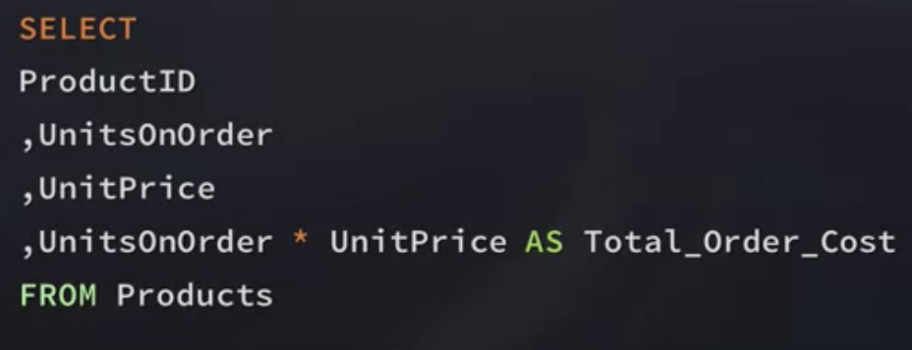
Math operations

Slide 20
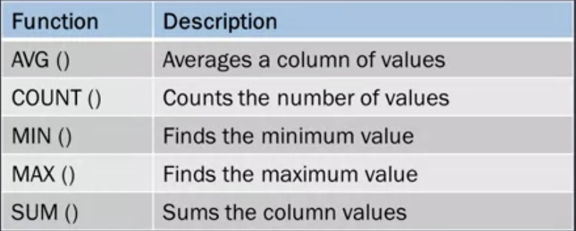
Aggregate Functions
Count singular columns to avoid counting NULL

Slide 21
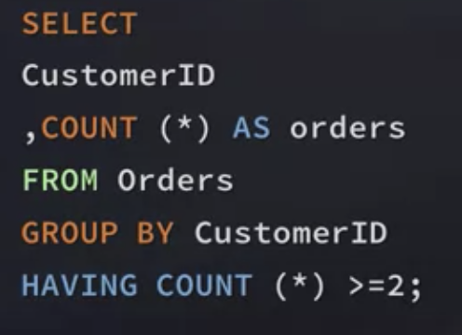
Grouping Data
Columns must be present the select statement if they are in group by

Slide 22
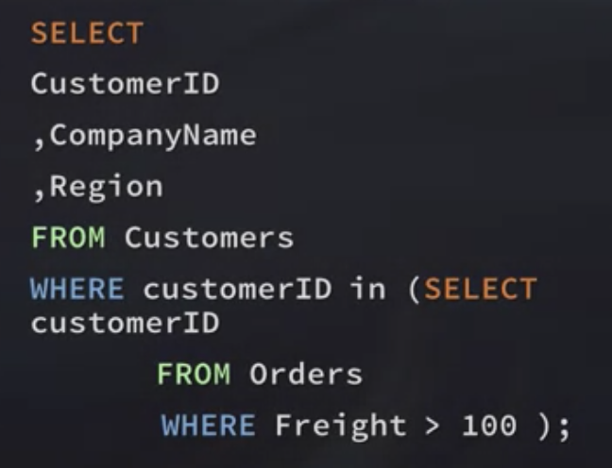
Subqueries
The inner query is processed first!
There is no limit to the number of subqueries
Performances slow down with the number of subqueries
They can retrieve only one column
Use https://poorsql.com/ to clean format

Slide 23
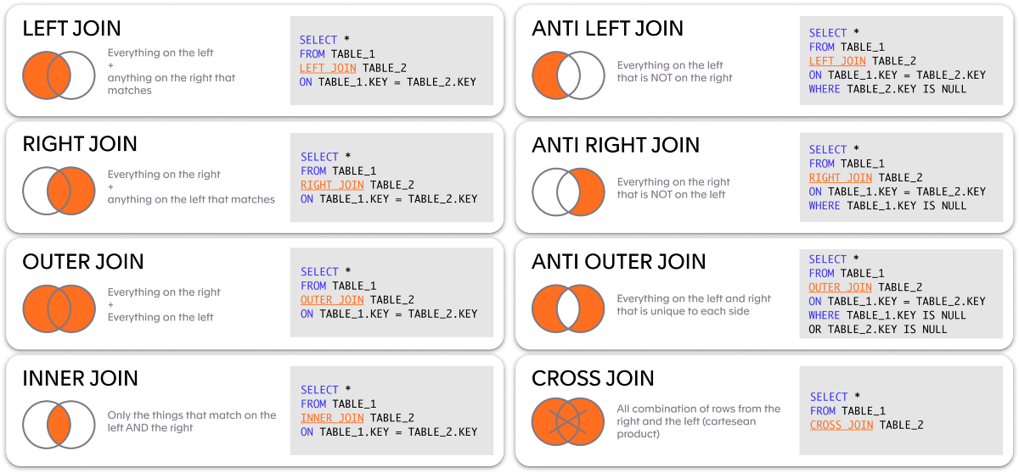
JOINs

Slide 24
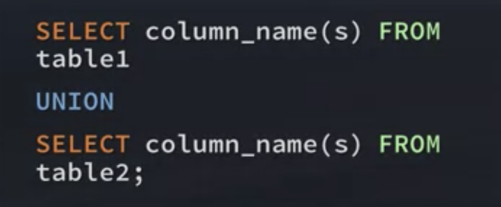
UNION

Slide 25
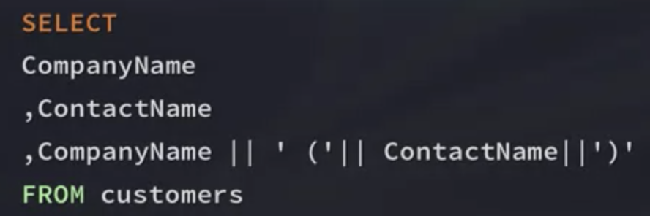
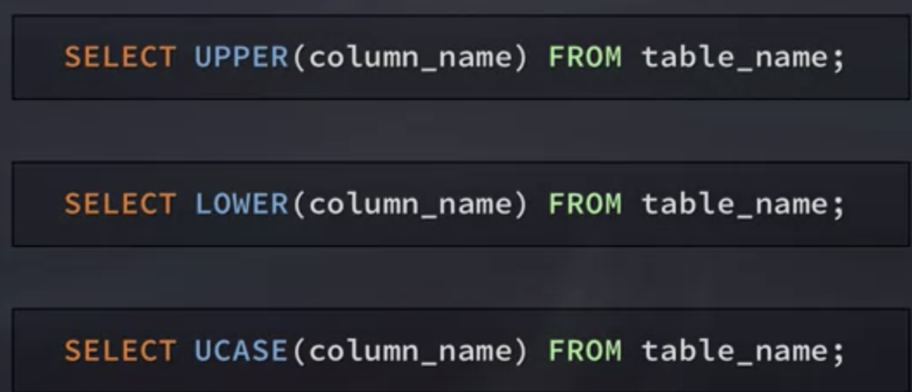
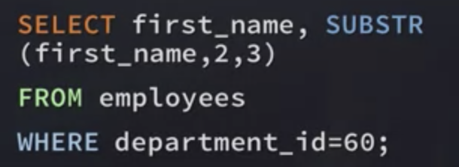
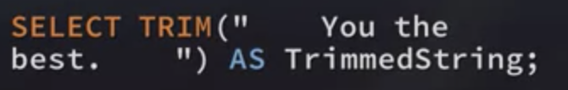
Working with text strings

Slide 26
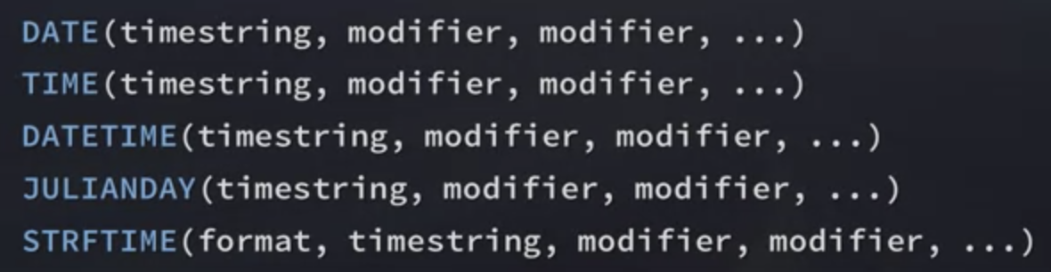
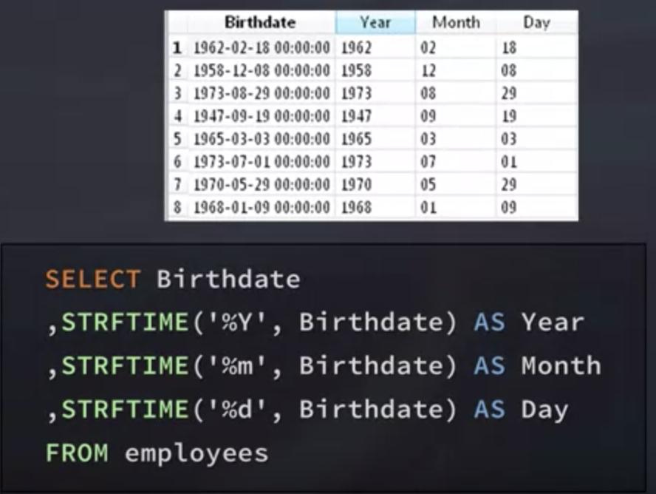
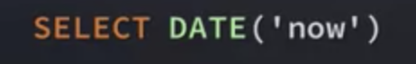
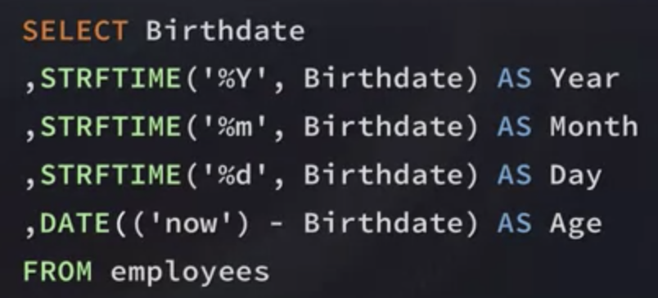
Working with dates
Compute current date
String format time function

Slide 27
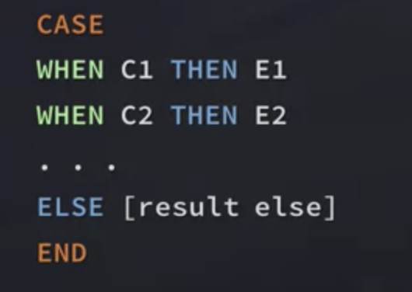
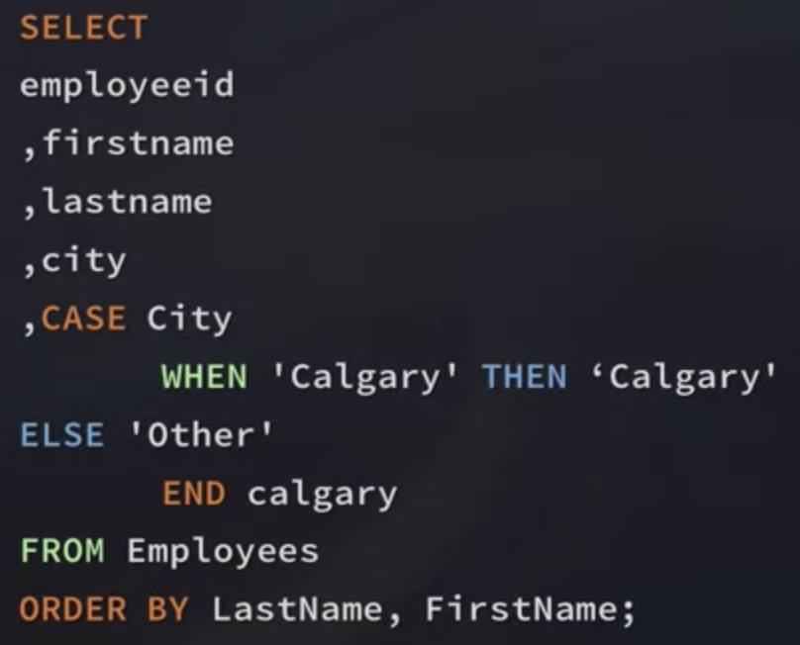
CASE statement
Can be used in INSERT, SELECT, UPDATE and DELETE

Slide 28
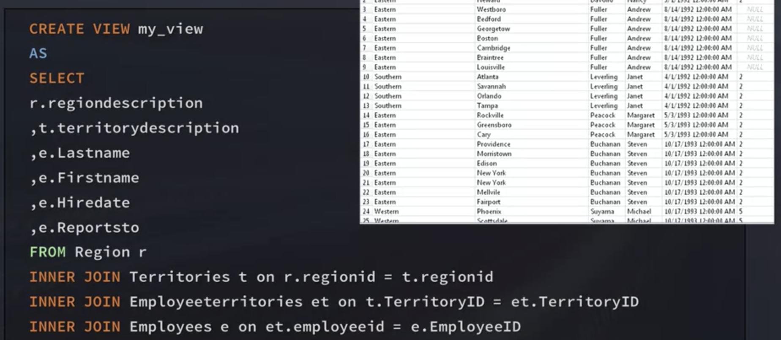
Views
To delete the view type DROP VIEW name_view

Slide 29
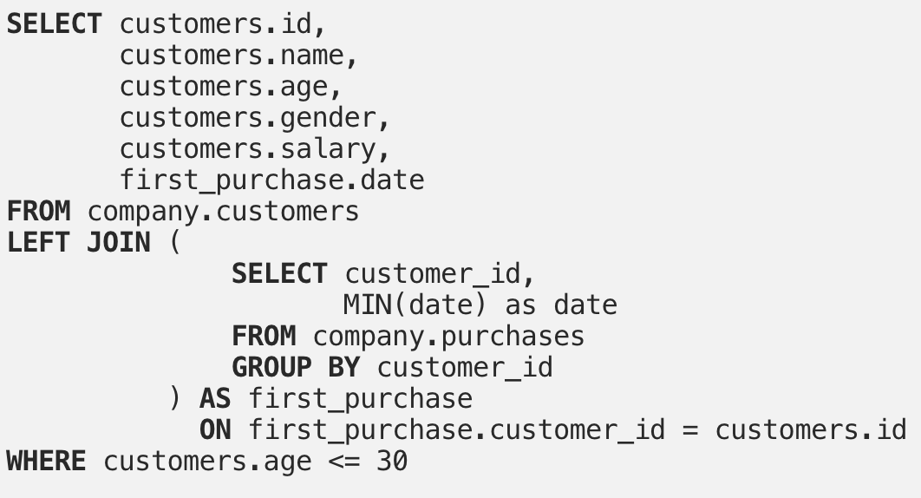
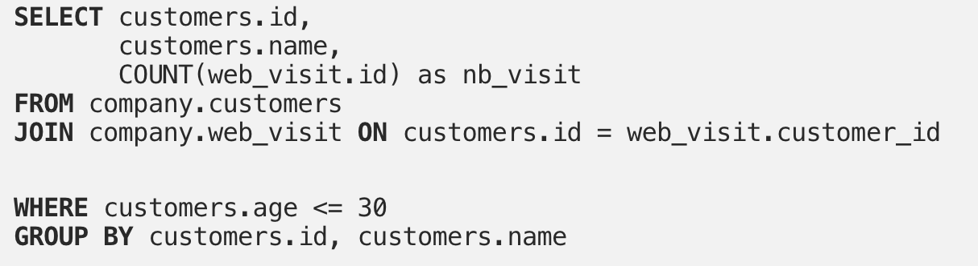
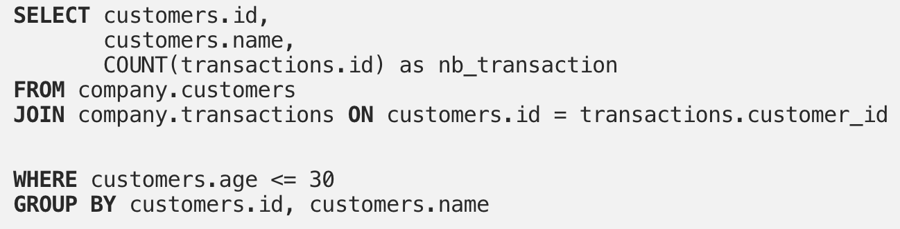
SQL Writing Best Practices
Uppercase for keywords
Use snake-case format
indentation
Use the ANSI-92 JOIN Syntax

Slide 30
Python

Slide 31
Pandas
Cross-tab

Slide 32
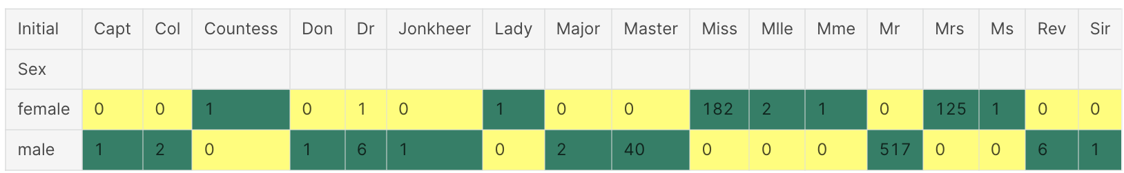
Cross tab
Cross-tabulation analysis, also known as contingency table analysis, is most often used to analyze categorical (nominal measurement scale) data. a cross-tabulation is a two- (or more) dimensional table that records the number (frequency) of respondents that have the specific characteristics described in the cells of the table. Cross-tabulation tables provide a wealth of information about the relationship between the variables.
pd.crosstab(data.Initial,data.Sex).T.style.background_gradient(cmap='summer_r')

Slide 33
Class Attributes vs Instance attributes
Class attributes are the variables defined directly in the class that are shared by all objects of the class.
Instance attributes are attributes or properties attached to an instance of a class. Instance attributes are defined in the constructor.

Slide 34
Statistics

Slide 35
T-test
A t-test checks if two means are reliably different from each other.
If we simply subtract the two mean we wouldn’t obtain a reliable result.
It’s a tool for inferential statistics, it can tell us statistics not only on our sample but on future samples as well.
Mathematically, the t-test takes a sample from each of the two sets and establishes the problem statement by assuming a null hypothesis that the two means are equal.
Example:
Imagine we want to test a new vaccine for COVID. Generally, two group are considered:
The first group gets the vaccine
The second group (Control) gets a panacea
At the end of the experiment, the first group has a mean of 10 people who has covid, whereas the mean for the second group is 15.
If we analyzed this problem through descriptive statistics we would say vaccine is working. However, this result is not reliable and thus we need to perform a T-test to assess it.

Slide 36
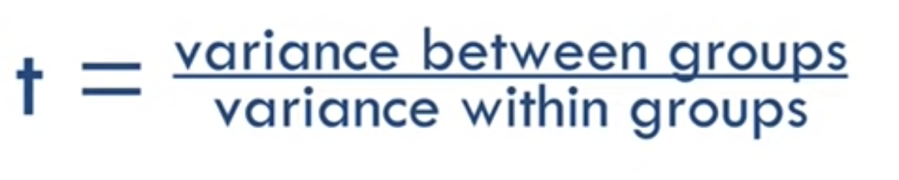
A T-value is the ratio of the variance between the groups and the variance within the groups.
Bigger: different groups.
Smaller: similar groups.
Each t-value has a corresponding p-value, which is the probability that the pattern produced in our data could be produced by random data (likelihood that there is a real difference).
p=.05 means 5% chance there is no real difference.
p=.01 -> 1%
Everything above is unreliable (e.g. 0.1)
Getting a small p-value when there is no difference is called False positive
Sample size affects p-value

Slide 37
Machine Learning Fundamentals
Sections:
Main ML models
Tree-Based Methods
Bias-Variance Tradeoff
Feature Engineering

Slide 38
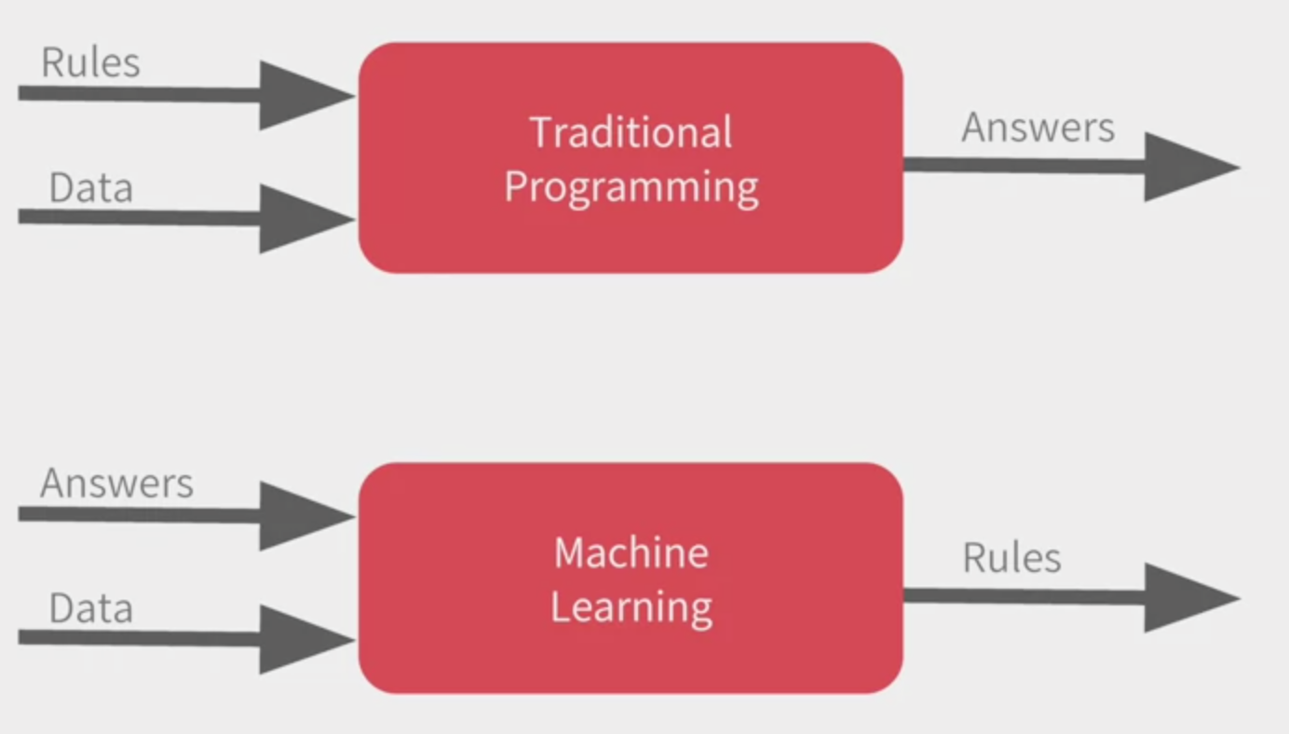
Machine Learning understand the patterns within the data and find out what the rules are.

Slide 39
Classification
Predicts the label Y given features X.
A linear model with weights w compute the dot product between w and X and if the result is positive, it is classified as positive class otherwise it will belong to the negative class. Dot product represents the confidence of the model in the prediction. If the dot product is zero but closer to zero, the model is not confident.
Thus, we cannot use MSE loss because it will penalise high confidence.
The score have to be converted to probability distribution (softma)
Cross-entropy gives high penalty for model that are confident in the wrong decision

Slide 40
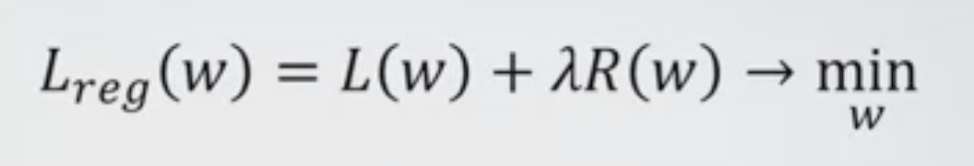
Penalization
Sometimes the model could have higher weights. We use regularization to avoid this. There are two common regularization techniques:
L1 penalty
Drives some weights exactly to zero
Not differentiable
L2 penalty
Drives weights closer to zero
differentiable

Slide 41
Main ML models
Linear regression
Ridge
Lasso

Slide 42
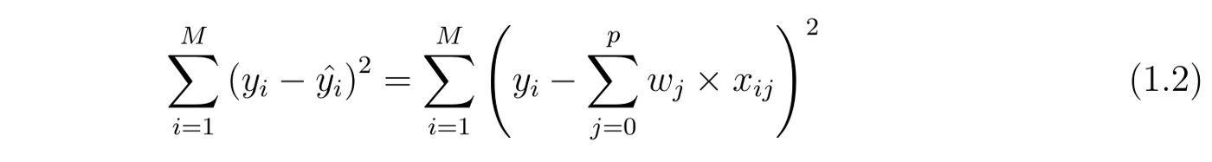
Linear regression
A linear model is one of the simplest way to predict output using a linear function of input features.
The objective of a linear regression is to optimize w and b such that it minimizes the cost function.

Slide 43
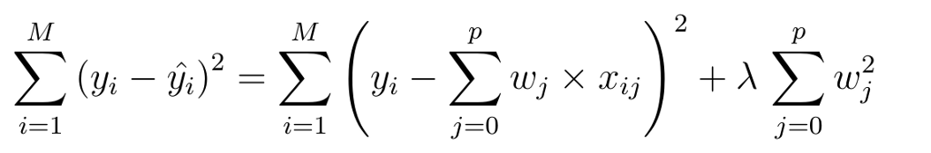
Ridge regression
The cost function is altered by adding a penalty equivalent to square of the magnitude of the coefficients.
The penalty terms put a constraint on the coefficients. They are shrinked because for some c>0, the penalty term should be less than c in order to minimize the cost function.
Thus, it helps reducing model complexity and multi-collinearity.
The lambda term controls the degree of penalty. The less the lambda value, the more it resembles to a linear regression.

Slide 44
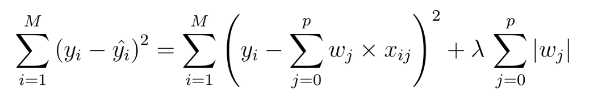
Lasso regression
Here, a L1 penalty terms is added to the cost function.
The only difference is instead of taking the square of the coefficients, magnitudes are taken into account. This type of regularization (L1) can lead to zero coefficients i.e. some of the features are completely neglected for the evaluation of output.
So Lasso regression not only helps in reducing over-fitting but it can help us in feature selection.

Slide 45
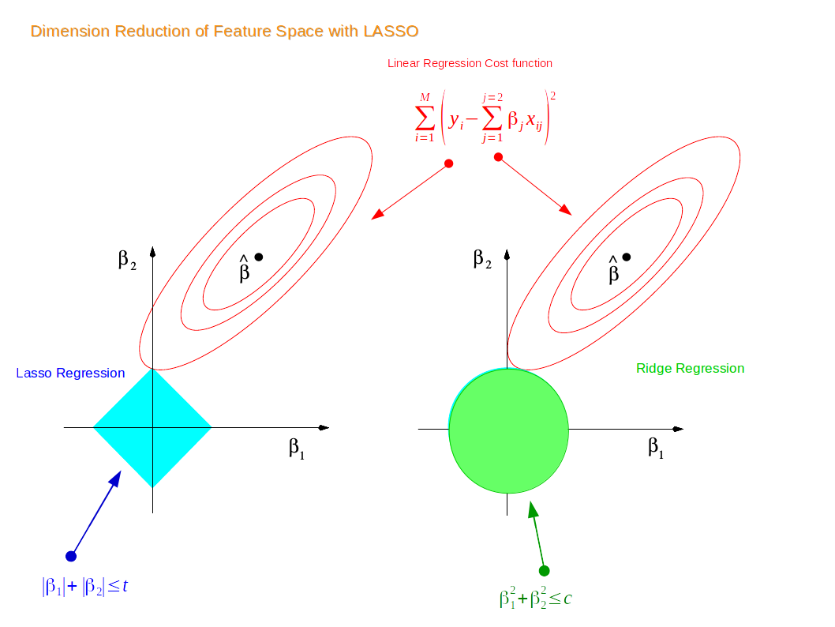
Detailed explanation of Lasso and Ridge
For a two dimensional feature space, the constraint regions are plotted for Lasso and Ridge regression with cyan and green colours. The elliptical contours are the cost function of linear regression. Now if we have relaxed conditions on the coefficients, then the constrained regions can get bigger and eventually they will hit the centre of the ellipse. This is the case when Ridge and Lasso regression resembles linear regression results. Otherwise, both methods determine coefficients by finding the first point where the elliptical contours hit the region of constraints.

Slide 46
Tree-Based
Methods
Decision Tree
Advantages and disadvantages of Decision Trees
Random Forest
Advantages and disadvantages of random forest
Gradient Boosting
GB Algorithm
Pseudocode (I)
Pseudocode (II)
Additional info
LightGBM
Leaf-wise growth algorithm
How to avoid overfitting with LGBM
Isolation forest

Slide 47
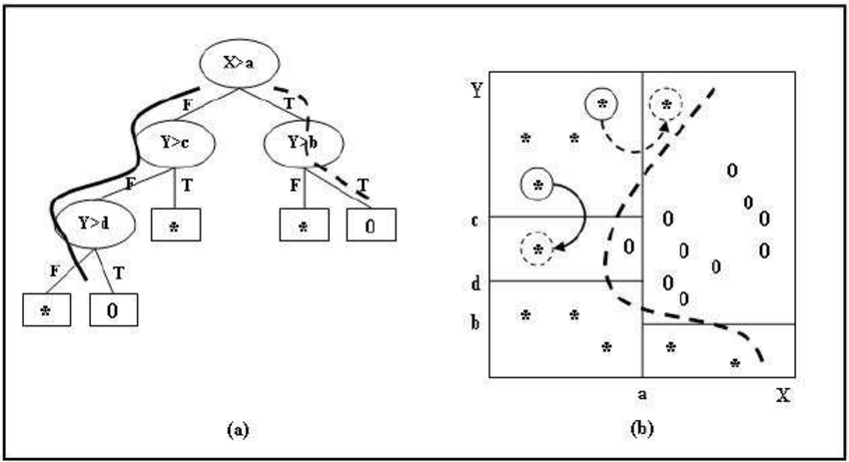
Decision Tree
Decision tree are non-parametric models that can be used both for classification and regression. They are flexible models that don’t increase their parameters as we add more features. When they are being built decision trees are constructed by recursively evaluating different features and using at each node the feature that best splits the data.

Slide 48
Advantages and disadvantages of Decision Trees
Advantages:
The main advantage of decision trees is how easy they are to interpret. While other machine Learning models are close to black boxes, decision trees provide a graphical and intuitive way to understand what our algorithm does.
Compared to other Machine Learning algorithms Decision Trees require less data to train.
They can be used for Classification and Regression.
They are simple and flexible.
They are tolerant to missing values.
You don’t need to scale the data
They are immune to multicollinearity
Disadvantages:
They are quite prone to overfitting to the training data and can be sensible to outliers.
They are weak learners: a single decision tree normally does not make great predictions, so multiple trees are often combined to make ‘forests’ to give birth to stronger ensemble models.
They are unstable, meaning that a small change in the data can lead to a large change in the structure of the optimal decision tree.

Slide 49
Random Forest
Random Forest consists of a large number of decision trees which operate as an ensemble. Each individual tree output a prediction and the final prediction is chosen thourgh a majority vote system.
The main idea is that a large number of uncorrelated trees will outperform a single tree.
In order to guarantee the uncorrelation between trees two techniques are used: bagging and feature randomness.
Bagging consists in train each tree on a new dataset obtained by sampling with replacement from the original one.
Feature randomness consists in train each tree on a random subset of features.

Slide 50
Advantages and disadvantages of random forest
Advantages:
Tend not to overfit. The processes of randomizing the data and variables across many trees means that no single tree sees all the data.
Handle non-linear parameters
Handle outliers
Disadvantages:
Prediction accuracy on complex problems is usually inferior to gradient-boosted trees.
Complexity increases with the number of trees
Higher training time

Slide 51
Gradient Boosting
Gradient boost starts by making a single leaf instead of a tree or stump.
The leaf represent an initial guess and it equal to the average of the the target outcomes.
Then new trees are created based on the error of the previous trees.
The trees are usually larger than ADAboost with maximum leaves between 8 and 32
Gradient boost scales the trees by the same amount.

Slide 52
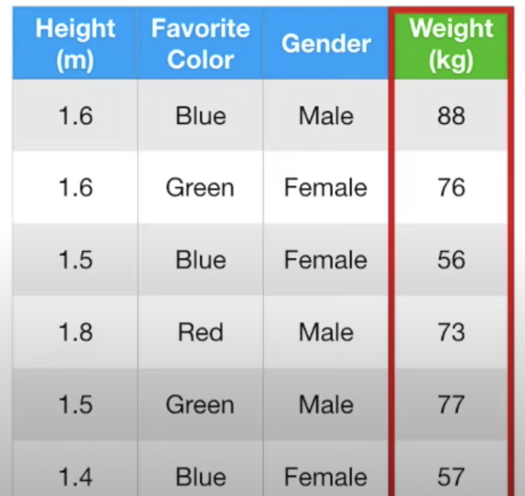
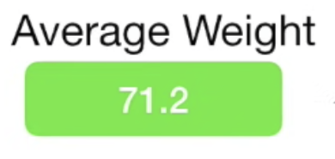
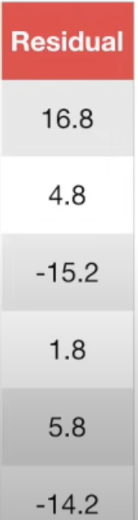
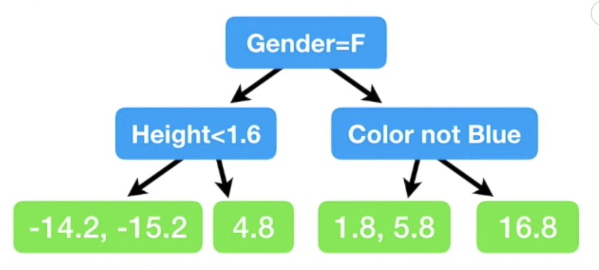
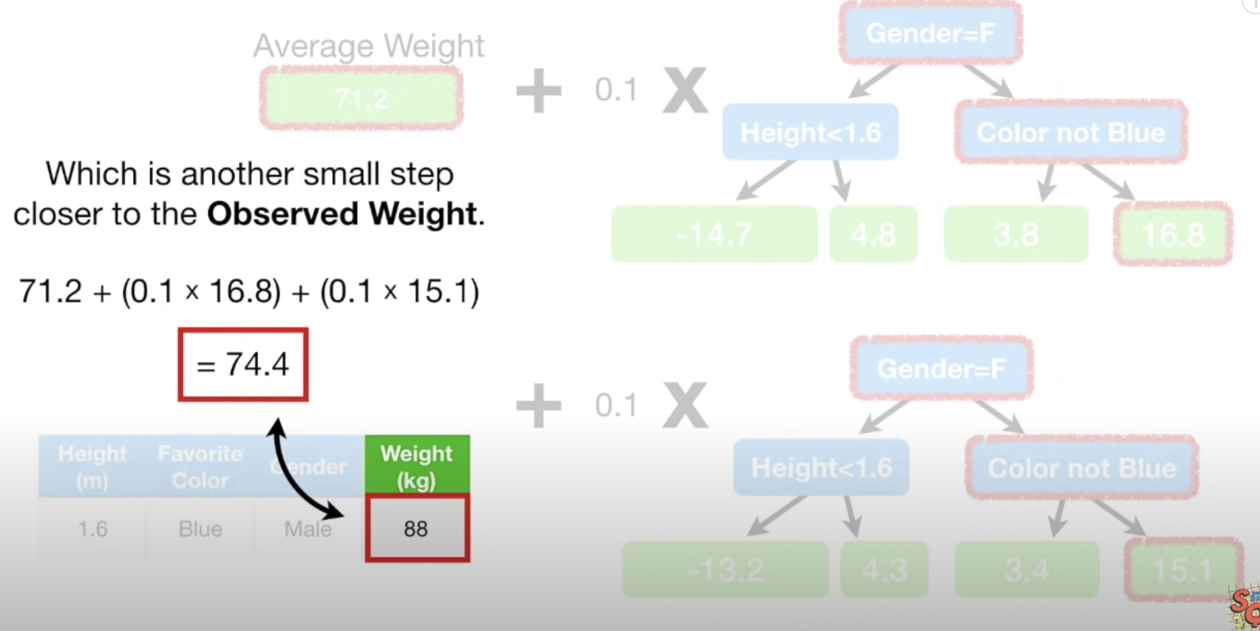
GB Algorithm
1
Initial dataset
2
Compute average
3
Compute residuals ->
avg - observed value
(could be any error function)
4
Build the three
5
Combine trees
In this case I have low bias and high variance
Scaling factor is needed in order to to have tradeoff between bias and variance

Slide 53
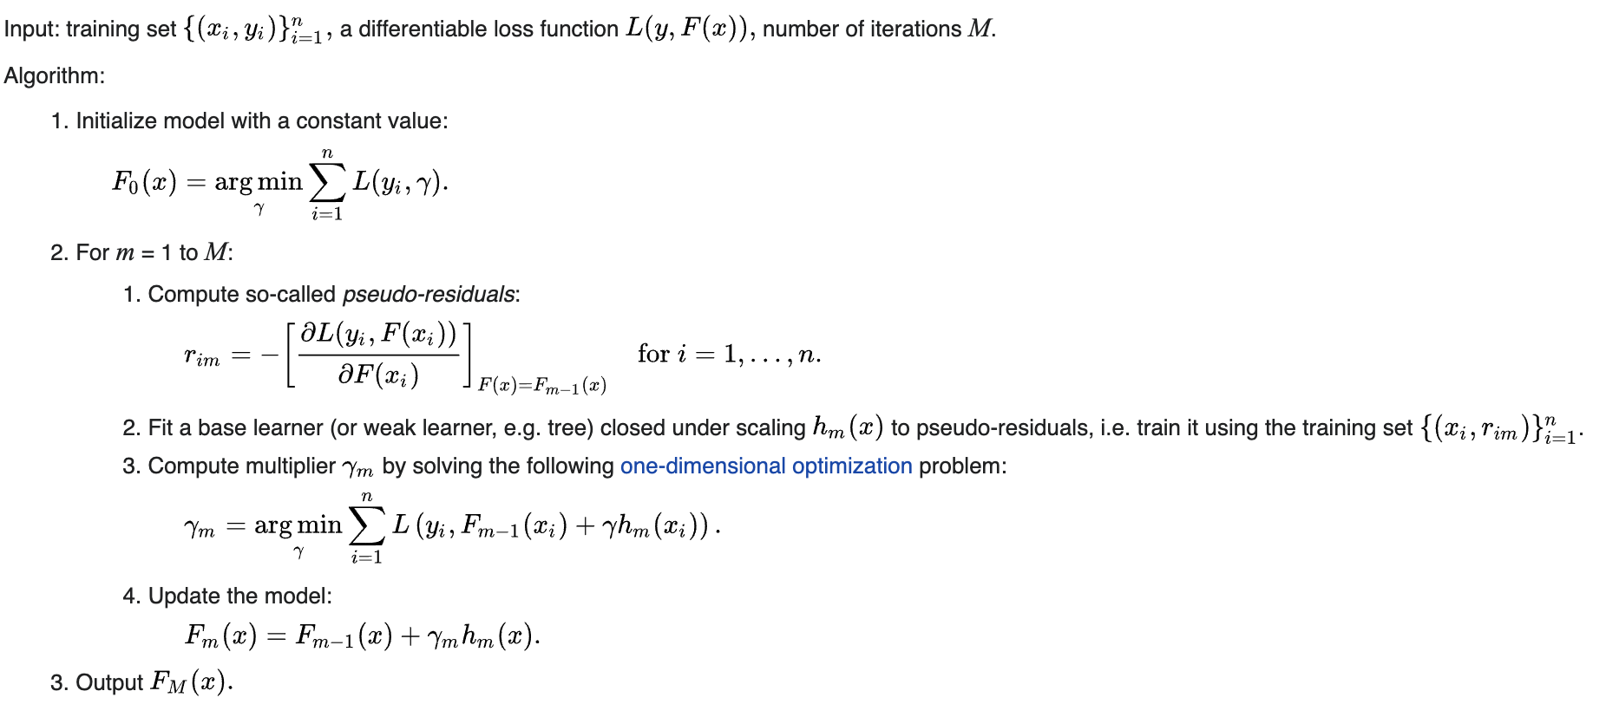
Pseudocode (I)

Slide 54
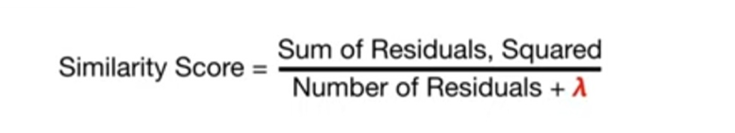
Pseudocode (II)
The first prediction is an initial guess and it’s usually 0.5 (regardless of being a classification or regression)
As GB algorithm it builds a regression tree from the residuals
However the trees are XGboost trees.
How to compute an XGBoost tree?
Put all the residuals on the first leaf
Compute root similarity score ->
Split the node for different threshold and compute gain for each split ->
Choose the split with the maximum gain
repeat
https://www.youtube.com/watch?v=OtD8wVaFm6E&t=1350s

Slide 55
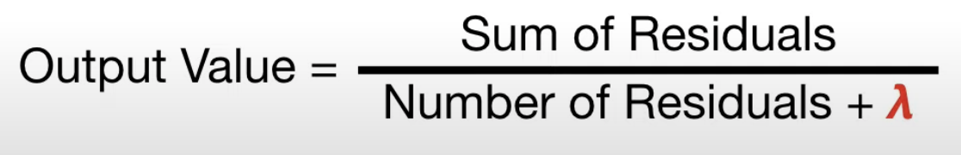
Additional info
If we want to prune we specify gamma and if the difference between gain and gamma is negative than the branch is removed
In the computation of the similarity score and further parameter lambda is added to the denominator and it works as a regularization terms.
Even if lambda is not set, we could have negative gains and so the branch is pruned as well -> prevent overfitting
Finally:
When lambda is 0, the output is the average of the residuals in the leaf

Slide 56
LightGBM
LightGBM is an efficient gradient boosting framework that uses tree-based learning.
Gradient Boosting
Faster than XGBoost
It could be used both for regression and classification
Distributed
Leaf-wise growth
Better accuracy
Work for imbalance data (is_unbalance)

Slide 57
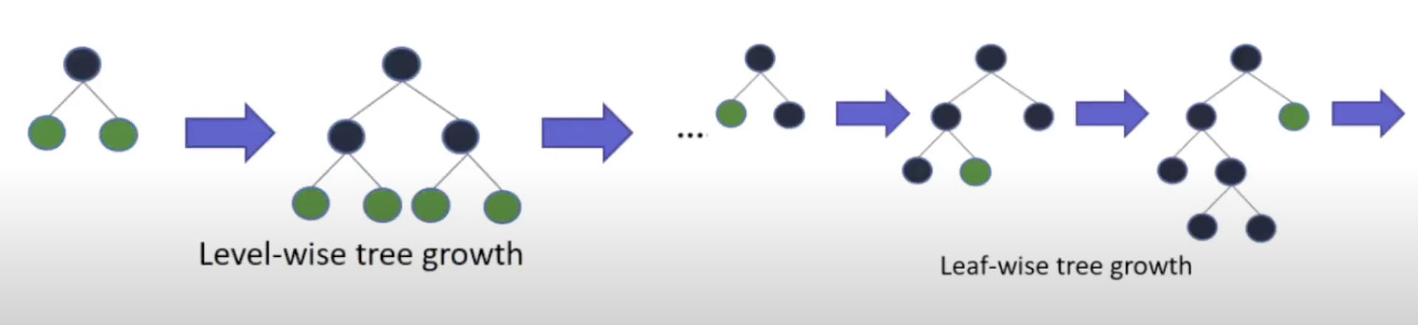
Leaf-wise growth algorithm
The big difference compared to the level-wise growth is that the trees are not balanced.
The leaf-wise strategy grows the tree by splitting the data at the nodes with the highest loss change.
Overfit with smaller dataset

Slide 58
How to avoid overfitting with LGBM
Increasing path_smooth
Larger training set
Regularization through lambda_l1, lambda_l2 and min_gain_to_split
Reduce depth

Slide 59

Isolation Forest
Isolation forest is an unsupervised ML algorithm for anomaly detection. The main idea behind is to isolate outliers in data.
It isolates the outliers by randomly selecting a feature from the given set of features and then randomly selecting a split value between the max and min values of that feature.
Using Isolation Forest, we can’t only detect anomalies faster but we also require less memory compared to other algorithms.

Slide 60
Bias-Variance
Tradeoff
Bias and variance
More details on bias and variance
Bias
Variance
Useful links on bias-variance topic

Slide 61



Bias and Variance
In the simplest terms, Bias is the difference between the Predicted Value and the Expected Value. Variance is when the model takes into account the fluctuations in the data i.e. the noise as well.
Bias: the inability of the model to capture the true relationship between variables.
Low bias: the model fits the training data very well
High bias: the model fails to fit the data
Variance: the difference in fit between datasets.
Low variance: model is too simplistic (underfitting)
High variance: the model fits the training data very well
train
test
Methods to find sweet spot between bias and Variance:
Regularization
Boosting
bagging
The best model has low bias and low variance

Slide 62




 | Low Variance | High Variance
Low Bias | The model is consistent and accurate | The model is uncertain but accurate.
High Bias | The model is consistent but inaccurate. | The model is uncertain and inaccurate on average
overfitting
Overfitting happens when a model exposed to too few examples learns patterns that do not generalize to new data, i.e. when the model starts using irrelevant features for making predictions.
underfitting

Slide 63



Slide 64


More details on Variance and Bias
When you want to look at the variance, look at the test error
When you want to look at the bias, look at the train error

Slide 65
Bias
It is based on the assumption that the model makes on the data. If we make the wrong assumption then the bias will be high.
Examples of models with high bias:
Linear regression is a common type of model which has high bias. This is because it assumes that the data are linear.

Slide 66
Variance
Variance shows the sensitivity of the model to the training data. Variance measures how different choices of the train sets would affect the the model parameters.
Examples of models with high variance:
Decision trees
if we don’t put any kind of limitation the decision tree can grow by fitting all the training data

Slide 67
Useful links on Bias-variance topic
https://towardsdatascience.com/bias-variance-trade-off-with-python-example-6519d2084be4
https://towardsdatascience.com/the-bias-variance-trade-off-explained-practically-in-python-48cf29d9e900

Slide 68
Learning Curve
A learning curve shows the validation and training score of an estimator for varying numbers of training samples. It is a tool to find out how much we benefit from adding more training data and whether the estimator suffers more from a variance error or a bias error.
Main indicator for bias is high validation term
Low or high bias? If the training error is very low it means that it has low bias with the respect of the set.
If the training error is high, it means it has high bias with the respect of the set.
Estimating Variance can be don by either examining the gap between the errors or bby examining the training error.
Narrow gap -> low variance
High training error -> low variance
https://www.dataquest.io/blog/learning-curves-machine-learning/

Slide 69
Feature Engineering
Permutation Feature Importance
Shap

Slide 70
Permutation Feature Importance
Permutation feature importance is a model inspection technique that can be used for any fitted estimator when the data is tabular. The permutation feature importance is defined to be the decrease in a model score when a single feature value is randomly shuffled. This technique benefits from being model agnostic and it breaks the relationship between feature and target.
Warning: Features that are deemed of low importance for a bad model (low cross-validation score) could be very important for a good model. Therefore it is always important to evaluate the predictive power of a model using cross-validation. Feature importance how important this feature is for a particular model.
from sklearn.inspection import permutation_importance
r = permutation_importance(model, X_val, y_val,
n_repeats=30,
random_state=0)
for i in r.importances_mean.argsort()[::-1]:
if r.importances_mean[i] - 2 * r.importances_std[i] > 0:
print(f"{diabetes.feature_names[i]:<8}"
f"{r.importances_mean[i]:.3f}"
f" +/- {r.importances_std[i]:.3f}")
Since the permutation feature importance relies on measurements of the model error, we should use unseen test data.

Slide 71

Shap
SHapley Additive exPlanations
They model the machine learning algorithm as a game concept where each player contribute to the final outcome
Staples values tell us how much is the contribution for each feature in order of obtaining a fair distribution
SHAP formula requires to train 2 ^ F models

Slide 72
Deep Learning

Slide 73


Kernels
A Kernel is a filter with a specific dimension which scans through the image and find patterns. The idea is that some convolutions will change the image in such a way that some features are emphasized.
Vertical lines are emphasized
orizonthal lines are emphasized

Slide 74

Pooling
Pooling is a way of compressing an image by preserving the features captured by the convolutions.

Slide 75
Weight Decay vs. Weight Restrictions
Both of them are regularization techniques
Weight Decay aims to reduce weights and biases by a small amount after their update.
Weight Restrictions aims to keep weights and biases within a specific range (clipping)
They prevent overfitting
Tips: exclude the bias term from weight decay
Weights of activation functions determines the slopes (overfitting)
Bias have no influence on the slopes of activation functions. However, they have an influence on the position of the activation functions in space.

Slide 76


Dropout
The idea behind it is to remove a random number of neurons in your neural network. This works very well for two reasons: The first is that neighboring neurons often end up with similar weights, which can lead to overfitting, so dropping some out at random can remove this. The second is that often a neuron can over-weigh the input from a neuron in the previous layer, and can over specialize as a result. Thus, dropping out can break the neural network out of this potential bad habit!
Applying dropout
Apply dropout when you see validation diverging away from training like this

Slide 77
Tips
If your learning curve is fluctuating for both training and validation it could be that you set a small batch size (https://www.youtube.com/watch?v=4qJaSmvhxi8).
If when increasing the batch size you get small fluctuations it could mean that you increased a little too much.

Slide 78

Stochastic Gradient descent
Gradient Descent is a technique aiming to optimize an objective function (loss function).
Unfortunately, this is unfeasible in a real scenario with lots of samples. Each step you should calculate l gradients.
In the real world we use Stochastic Gradient Descent which compute the gradient on one sample.
The disadvantage is that you will have noisy fluctuations but you can perform one step of GD with one sample.
A combination of the two is Mini-batch GD in which the optimization is made on a subset of samples. It has the advantage of reducing variance in gradients approximations.

Slide 79


Momentum
It is used to achieve better convergence. We keep tracking of a vector h which is a weighted sum of the gradients from current to previous iterations. If the gradients points at the same direction this vector will get larger and so the update. Otherwise, the values will cancel out if steps going in opposite directions.

Slide 80
Scrum

Slide 81
Definition
Scrum is a lightweight framework that helps people, teams and organizations generate value through adaptive solutions for complex problems.
What is the difference between Agile and Scrum?
Agile is a development methodology based on iterative and incremental approach.
Scrum is one of the implementation of agile methodology.

Slide 82
Scrum Team
Made by:
Scrum Master
Product Owner: orders the work for a complex problem into a Product Backlog.
Developers
Scrum team are cross-functional (all the members have the necessary skills to perform a sprint).
Fewer than 10 people (smaller team communicate better)

Slide 83
Pillars
Transparency
Inspection
Adaptation

Slide 84
Developers
Committed to creating any aspect of a usable increment each sprint.
Accountable for:
Creating a plan for the sprint (sprint backlog).
Meet product quality by requirements
Adapting their plan each day
Holding each other accountable

Slide 85
Product Owner
Accountable for Product backlog management.
Developing and communicate product goal.
Creating product backlog items.
Ordering product backlog.
Ensuring that product backlog is transparent, visible, and understood.
It is one single person

Slide 86
Scrum Master
Help others applying scrum.
Accountable for team’s effectiveness.
His jobs:
Coaching the team embers in self-management
Helping team on creating increments that meet Definition of Done.
Remove possible impediments.

Slide 87
Jupyter notebook

Slide 88
Alert Boxes
<div class="alert alert-block alert-success" style="border-radius:8px box-shadow: rgba(0, 0, 0, 0.1) 0px 1px 3px 0px, rgba(0, 0, 0, 0.06) 0px 1px 2px 0px;">
<b>&#10149; See also<br/></b> Use green boxes to link to other documentation sources.
</div>
<div class="alert alert-block alert-danger" style="border-radius:8px box-shadow: rgba(0, 0, 0, 0.1) 0px 1px 3px 0px, rgba(0, 0, 0, 0.06) 0px 1px 2px 0px;">
<b>!&#x20DD;Warning<br/></b> In general, avoid the red boxes. These should only be
used for actions that might cause data loss or another major issue.
</div>
<div class="alert alert-block alert-warning" style="border-radius:8px box-shadow: rgba(0, 0, 0, 0.1) 0px 1px 3px 0px, rgba(0, 0, 0, 0.06) 0px 1px 2px 0px;">
<b>&#33; Important<br/></b> Use yellow boxes if you to underline important things.
</div>
<div class="alert alert-block alert-info" style="border-radius:8px">
<b>&#9432; Tip<br/></b> Use blue boxes (alert-info) for tips and notes.
If it’s a note, you don’t have to include the word “Note”.
</div>

Slide 89
Data Visualization

Slide 90
Generic terms
Aesthetics describe every aspect of a given graphical element.
Positions
Scales
Size
Color
…
Type of variable
Quantitative
Continuous -> real numbers
Discrete -> integer numbers
Qualitative
Categorical
Ordered (dog, cat)
Unordered (good, fair, poor)
Date
text

Slide 91

Y-axis continuous.
X-axis categorical ordered.
Color categorical unordered.
Two position scales and one color scale.
Scale is a mapping between a value and an aesthetic.

Slide 92

Same data but different visualization. We have two discrete position scales (Temp and month). The location is unordered and so their order is arbitrary. In this case we can decide to pot from the coldest (chicago) to the hottest (death valley)

Slide 93
Log Scaling
A modification of the log transformation can help spread out the magnitude of the data while preserving the sign of data. It is called the log-modulus transformation (John and Draper, 1980). The transformation takes the logarithm of the absolute value of the variable plus 1. If the original value was negative, "put back" the sign of the data by multiplying by –1. In symbols, L(x) = sign(x) * log(|x| + 1)

Slide 94
Rstudio

Slide 95





Merging Datasets Horizontally
df1 %>% bind_cols(df2)
demographics %>% left_join(grip_strength, by = "id")
demographics %>% right_join(grip_strength, by = "id")
demographics %>% full_join(grip_strength, by = "id")

Slide 96

Merge Datasets Vertically
trial %>% bind_rows(trial_2020)
trial %>%
bind_rows(
trial_2020 %>%
rename(
n = count,
outcome = outcomes
)
)
Same columns structure
Equal columns but not consistent

Slide 97


Kable | KableExtra
Plot fancy table/dataframe in a report using kable library
Df %>% kbl()
Df %>%
kbl(caption=’title’) %>%
kable_styling(bootstrap_options = c("striped", "hover"))

Slide 98
Time series Forecasting

Slide 99

What is a time series forecasting?
A time series is a series of values during time.
Forecasting is the process of predicting future values based on previous values.
Building a model that can predict the future based on historical data.
Forecasting Process:
Define goal
Get data
Explore & visualize series
Pre-process data
Partition series
Apply forecasting methods
Evaluate
Implement forecast system

Slide 100
Basic notation
t = 1,2,3, … is the index denoting the time period of interest
F_{t} is the forecasted value for time t
e_{t} is the forecast error for time period t, which is the difference between the actual value and the forecast at time t.
K is the number of periods ahead that we must forecast (Horizon).
Large horizon implies that the forecast context will likely change.

Slide 101
Feature Engineering
Date time features: components of the time step.
Lag Features: values at prior time steps.
Window Features: summary of values over a fixed window
Rolling Window: fixed, add a summary of the values at previous time steps
Expanding Window: increasing, summary of values which increase (maximum till date x).
features['lag1'] = dataframe['births'].shift(1) ## 1 timestep before
features['roll_mean'] = dataframe['births'].rolling(window=2).mean() ## mean between actual value and the previous one
Features[‘expand_ma’] = dataframe['births'].expanding().max() ## max value till the actual timestep

Slide 102
Resampling
Change the frequency of the data
Upsampling: increase the frequency of the data (from the months to date)
Downsampling: decrease the frequency of the data (from day to months)
In both the case the data are invented

Slide 103

Autocorrelation
It shows the properties of time series data
It is designed to show whether the elements of a time series are positively correlated, negatively correlated, or independent of each other.
The horizontal axis of an autocorrelation plot shows the size of the lag between the elements of the time series.
The vertical axis shows the value of the autocorrelation function (acf) ranging from -1 to 1.

Slide 104

Transformations
Changing scales
If our data have an exponential trend we can compute the log of the data in order to get a linear trend (some model perform well with linear trend)
Moving Average
Creating new series where values are averages of the raw observations
It can be used to eliminate the noise in the data
Simple exponential smoothing
Weighted average of the values
F(t+1) = 𝞪 * y(t) + 𝞪* (1 - 𝞪) y(t-1) + 𝞪 * (1 - 𝞪)^2y(t-2) + ...

Slide 105

Randomness
White noise: the series is completely random
Random Walk: only the previous step is significant for the predicting the next values
Naive models gives the best results.
X(t) = X(t-1) + Z(t) where Z(t) ~ Normal(𝜇, σ^2)
A random walk is not a stationary time series and the acf will shows high correlation even for more lag steps back.
So how do we transform it into a stationary time series?
If we consider the previous formula we could obtain:
X(t) - X(t-1) = Z(t) which is stationary.

Slide 106
Time series decomposition
Each Time series can be decomposed into 4 components:
y(t) = Level + Trend + Seasonality + Noise (ADDITIVE)
Multiplicative: y(t) = Level * Trend * Seasonality * Noise
(*) use seasonal_decompose from statsmodels package.
Random values
Average value
increasing/decreasing of the series
Repeated cycles in the series

Slide 107
Differencing
We need to remove trend and seasonality in order to get stationary time series
Time series are much easier to model
Stationary means that summary statistics of the observations are preserved.
The observations in a stationary time series are not dependent on time.
Differencing is one technique which allow us to do so.
difference(t) = observation(t) - observation(t-1)
A trend makes a time series non-stationary by increasing the level. This has the effect of varying the mean time series value over time.
To remove it compute the lag-1 difference
Seasonal variation, or seasonality, are cycles that repeat regularly over time.
To remove it, we need to subtract the entire cycle.

Slide 108
Multiple Time Series
Sometimes we need more that one time series to make good predictions
We must understand the relations between features and their causality
We can prove it with Granger Causality Test:
X(t) Granger causes Y(t), if the past values of X(t) helps in predicting the future values of Y(t)
Y(t) = F(Y(t-p), X(t-p))
Cause happen prior to effect
Y(t) = f(X(t-1) and not Y(t) = f(X(t))

Slide 109
LSTM

Slide 110
Overview
Long short-term memory
Subclass of Recurrent Neural Network (feed-forward neural network unrolled in time)
According to RNN, order and content are equally important
They solve the vanishing gradient problems in vanilla RNN
the operation typically entails repeatedly multiplying an error signal by a series of values (the activation function gradients) less than 1.0, attenuating the signal at each layer.
They are made up by gates which monitor the flow of informations:
Input gate
Forget gate
Output gate
Gates are useful to decide which parts are important in a sequence
Applications: Time series, Speech recognition, computer vision...

Slide 111


LSTM gates
Steps:
Combine previous hidden state and current input.
Forget gate chooses what values of the old cell state to get rid oft:
Close to 0 -> forget.
Close to 1-> keep
Input gate decide what to add to the cell state depending on the input.:
Inputs goes to a sigmoid
The tanh is used to add regularization
Multiply:
Sigmoid output will decide which information to keep from the tanh output
Compute cell state
Output gate decide what the next hidden state should be
RNN
LSTM Gate
Cell state transports relative information down to the sequence chain (memory of the network).

Slide 112
Different LSTM Models
Classic LSTM
This architecture consists of 4 gating layers through which the cell state works, i.e., 2-input gates, forget gate and output gates. The input gates work together to choose the input to add to the cell state. The forget gate decides what old cell state to forget based on current cell state. The output gates decides what output to be sent through them.
Stacked LSTM
The Stacked LSTM is nothing but an LSTM Model with multiple LSTM layers. The LSTM layer gives a sequential output to the next LSTM layer.
Bidirectional LSTM
The Bidirectional LSTM trains two on the input sequence instead of one which means the first input sequence and the second is its reversed copy of the same. The improves the learning of the model more faster.
GRU(Gated Recurrent Unit)
The Gated Recurrent Unit Neural Networks basically consist of two gates i.e., Reset Gate and Update Gate. Reset Gates help capture short-term dependencies in sequences and Update Gates help capture long-term dependencies in sequences. Both the gates control how much each hidden unit has to remember or forget while working on the sequence.
BGRU(Bidirectional GRU)
As Bidirectional LSTM, the Bidirectional GRU is also a Bidirectional RNN, which means, the BGRU is nothing but the GRU in a bidirectional manner.

Slide 113
Transformers
Attention Is All You Need

Slide 114

Model

Slide 115
Overview
Take a sequence of vectors as input and output another sequence
The sequence length could vary without changing the model parameters
The basic operation is Self-attention
Self-attention aims to take the best of sequential RNN processing and parallel processing of CNN
It attempts to associate each individual word in the input to other words
https://www.youtube.com/watch?v=4Bdc55j80l8
https://data-science-blog.com/blog/2021/04/07/multi-head-attention-mechanism/

Slide 116




Self-attention (basic)
formula:
All the weight must sum up to 1 (softmax)
Single-step

Slide 117




Self-attention (complex)
Scaled dot product
Dot product is sensible to the size of the input vectors
Key, value and query transformations
The operation is a soft version of a dictionary
Multi-head attention
The need is based on the fact that different words are related

Slide 118
Key, query and values explanation
https://stats.stackexchange.com/questions/421935/what-exactly-are-keys-queries-and-values-in-attention-mechanisms
The key/value/query concepts come from retrieval systems. For example, when you type a query to search for some video on Youtube, the search engine will map your query against a set of keys (video title, description, etc.) associated with candidate videos in the database, then present you the best matched videos (values).
Looking at the self attention formula, we know that the weights sum up to 1, so we can think of them as a one hot vector which select information.

Slide 119








Multi-headed attention
This layer computes the attention weight for the input and produces an output vectors which encode the information about how each word should attend other words in the sequence

Slide 120
Gradient Boosting Trees Methods

Slide 121
Gradient Boosting

Slide 122
NLP

Slide 123
Main approaches to NLP
Rule-based approach
You have to write all the rules
You have high precision but low recall
Machine learning
We need a corpus with markups
You need to do feature engineering
Can be different kind of models (like statistical)
Deep learning

Slide 124
Where is NLP used?
Machine Translation: task of automatically converting one natural language into another.
Text Classification: processo of assigning tags or categories to text according to its content.
Topic Modeling - analyzes text data to find patterns and recurring words within text (unsupervised).
Topic Classification - requires training and it therefore knows topic in advance (supervised).
Sentiment Analysis: task which identifies and extracts information based on polarity (positive, negative, neutral), feelings and emotions (angry, happy, sad…), and intensions (interested or not interested).

Slide 125
Sentiment Analysis
Predict if a review is positive or negative.
It is possible to use logistic regression for doing so.

Slide 126
Feature Extraction
How to represents a text as a vector?
Build a vocabulary.
Build a vector V as a list of unique words the can occur in the sentences.
The representation will have a number of features equal to the size of the vocabulary.
The vocabulary dictionary maps the word and the class to the frequency.
After that we build a feature vector which contains:
Bias
Sum up of positive frequencies
Sum of negative frequencies

Slide 127
Preprocessing
Removing stop words and punctuation (words that don't add significant meaning)
Removing URLs
Lowercasing
Tokenization
Stemming (converting a word to its most general form, or stem, e.g tuning->tune)
Lemmatization
… to preprocess sentences use NLKT libraries.

Slide 128

Tokenization
It splits the sentence in words which are associated with tokens.
nltk.tokenize.WhiteSpaceTokenizer -> split using white spaces
nltk.tokenize.WordPunctTokenizer -> split using punctuations
nltk.tokenize.TreebankTokenizer -> use english grammar rules to tokenize

Slide 129


Token Normalization
Stemming: it is the process of removing suffixes and extracting the root of the word
Lemmatization: return the base form of a word
Lowercase words
Convert Acronyms

Slide 130
Representing Text Data (Bag-of-Words)
It is a representation of the text that describes the occurrence of words within the document.
Scikit-learn
CountVectorizer (score is based on the word count)
HashingVectorizer (use Hash function to reduce the vector length)
TfidfVectorizer (based on the occurrence within the document and the inverse occurrence across all documents)
Inverse frequency refers to diminishing of the weight of terms that occur very frequently in the document set (e.g “the”).
Keras
Tokenizer
These methods don’t preserve the relationship between words!!

Slide 131

Feature Extraction
Bag of Words (BOW): Count the occurrences of tokens in a document
For each token we will have a feature column
Problems:
Words order is not preserved
Counters are not normalized
Extract n-grams instead of words but you will end up having high number of features. To solve that eliminate high frequency n-grams (stop words), low frequency and keep medium frequency

Slide 132

How do we compute the frequency?
Term frequency (Tf)
Binary
Raw count
Normalized frequency
Log normalization
Tf-idf

Slide 133

max_df is used for removing terms that appear too frequently, also known as "corpus-specific stop words". For example:
max_df = 0.50 means "ignore terms that appear in more than 50% of the documents".
max_df = 25 means "ignore terms that appear in more than 25 documents"
min_df is used for removing terms that appear too infrequently. For example:
min_df = 0.01 means "ignore terms that appear in less than 1% of the documents".
min_df = 5 means "ignore terms that appear in less than 5 documents".

Slide 134

Representing Text Data (Word Embeddings)
It is a type of word representation where similar words have similar representations.
Statistical methods: creating co-occurence matrix (count each pair occurs together)
Predictive methods: training a machine learning algorithm to make predictions based on the words and their contexts.
Word2vec:
CBOW (continuous Bag of Words) - try to predict the word given the one-hot encoded vectors of its context.
Skip-gram - try to predict the context given the word.
They are really good when used for transfer learning (pay attention to the context)

Slide 135

Word2Vec
https://gdcoder.com/what-is-an-n-gram-multichannel-convolutional-neural-network-for-text-classification/
Converts words into a vector space
Preserve relationship between them
Deal with addition of new words
Words that have similar context tend to have collinear vectors

Slide 136


Deep Learning approach (Words)
Using 1D conv layer we can convolve words and we’ll have high activation for 2-grams with certain meaning
Take the maximum activation for each filter

Slide 137

Deep Learning approach (Characters)

Slide 138
Tensorflow

Slide 139
Training
Define a sequence of layers
Model = keras.Sequential([
keras.layers.Flatten(input_shape=(28,28)),
keras.layers.Dense(128, activation=tf.nn.relu),
keras.layers.Dense(10, activation=tf.nn.softmax)
])
Turns an (28,28) array into a simple linear array
Defines the activation function to be used after the layers
Define a layer of connected neurons
model.compile(optimizer=’sgd’,
loss=’mean_squared_error’,
metrics=['accuracy']
)
model.fit(X, Y, epochs=500)
The process consist of making a guess, the loss measure how bad the guesses are and then the information is passed to optimizer which will figure out what will be the next guesses

Slide 140
Writing code to load training data
Fashion_mnist = tf.keras.datasets.fashion_mnist
(train_images, train_labels), (test_images, test_labels) = fashion_mnist.load_data()
Public API where you can load famous datasets

Slide 141

Callbacks
## custom callback
class myCallback(tf.keras.callback.Callback):
Def on_epoch_end(self, epoch, logs={}):
If (logs.get(‘loss’) < 0.4):
print(“Loss is low so cancelling training”)
Self.model.stop_training = True
## learning rate scheduler
lr_schedule = tf.keras.callbacks.LearningRateScheduler(
lambda epoch: 1e-8 * 10**(epoch / 20))
lrs = 1e-8 * (10 ** (np.arange(100) / 20))
plt.semilogx(lrs, history.history["loss"])
plt.axis([1e-8, 1e-3, 0, 300])
Choose stable value as lr

Slide 142
Convolutional Neural Networks
Model = tf.keras.Sequential([
keras.layers.Conv2d(64, (3,3), activation=’relu’,
input_shape=(28, 28, 1)),
keras.layers.MaxPooling2d(2,2),
keras.layers.Conv2d(64, (3,3), activation=’relu’),
keras.layers.MaxPooling2d(2,2),
keras.layers.Flatten(),
keras.layers.Dense(128, activation=’relu’),
keras.layers.Dense(10, activation=’softmax’),
])
Kernel dimension
Number of filters
Here you have the features
N.B. A CNN could be faster than

Slide 143
Lambda Layers
This layer allows to perform arbitrary operations.
model = tf.keras.models.Sequential([
tf.keras.layers.Lambda(lambda x: tf.expand_dims(x, axis=-1),
input_shape=[None]),
tf.keras.layers.SimpleRNN(40, return_sequences=True),
tf.keras.layers.SimpleRNN(40),
tf.keras.layers.Dense(1),
tf.keras.layers.Lambda(lambda x: x * 100.0)
])

Slide 144

ImageDataGenerator
Automatically load and label images organized in folders like below.
From tf.keras.preprocessing.image import ImageDataGenerator
Train_datagen = ImageDataGenerator(rescale=1./255)
Train_generator = train_datagen.from_from_directory(
Train_dir,
target_size=(300,300),
batch_size=128,
class_mode=’binary’)

Slide 145
Fitting with ImageDataGenerator
History = model.fit(
Train_generator,
steps_per_epoch=8,
epochs=15,
validation_data=validation_generator,
validation_steps=8,
verbose=2
)
Number of images / batch_size

Slide 146
Image augmentation
Data augmentation is a technique that might solve overfitting. It increases the variety of data. After image augmentation the training loss might decrease because the model needs more runs to capture all the variety of the dataset but the validation accuracy will match the training one.
Train_datagen = ImageDataGenerator(
rescale=1./255,
rotation_range=40,
width_shift_range=0.2,
height_shift_range=0.2,
shear_range=0.2,
zoom_range=0.2,
horizontal_flip=True,
fill_mode=’nearest’
)
Shift the image horizontally or vertically by 20% offset
Images augmentation introduces a noise in the training set and we might have fluctuating validation accuracy because the randomness introduced does not appear in validation
Fill the pixels that might have been lost during operations

Slide 147
Transfer Learning
From tensorflow.keras.applications.inception_v3 import InceptionV3
Local_weights_file = ‘/tmp/inception_v3_weights_tf_dim_ordering_tf_kernels_notop.h5’
Pre_trained_model = InceptionV3(input_shape = (150,150, 3),
Include_top = False,
Weights = None)
pre_trained_model.load_weights(local_weights_file)
For layer in pre_trained_model.layers:
Layer.trainable = False
Get only convolutional layers
Freeze layers

Slide 148
Multi-class Classification
Train_generator = train_datagen.from_from_directory(
Train_dir,
target_size=(300,300),
batch_size=128,
class_mode=’categorical’)
Model = keras.Sequential([
keras.layers.Flatten(input_shape=(28,28)),
keras.layers.Dense(128, activation=tf.nn.relu),
keras.layers.Dense(10, activation=tf.nn.softmax)
])
model.compile(optimizer=RMSprop(lr=0.001),
loss=’categorical_crossentropy’,
metrics=['accuracy']
)
One-hot encoded label: CategoricalCrossEntropy
Integer-Encoded Label: SparseCategoricalCrossEntropy

Slide 149
NLP
Tokenizer
Padding
Word Embedding
LSTM

Slide 150
Tokenizer
From tensorflow.keras.preprocessing.text import Tokenizer
Sentences = [
‘I love my dog’,
‘I love my cat’
]
Tokenizer = Tokenizer(num_words = 100, oov_token=’<OOV>’)
tokenizer.fit_on_texts(sentences)
Word_index = tokenizer.word_index
Take the top 100 frequent words and encode them
If the word is not in the vocabulary it is replaced with this token
Key-value pairs where key is the word and value is the token

Slide 151
Padding
From tensorflow.keras.preprocessing.sequence import pad_sequences
tokenizer = Tokenizer(...)
tokenizer.fit_on_text(sentences)
Sequences = tokenizer.texts_to_sequences(sentences)
Padded = pad_sequences(sequences, padding=’post’,truncating=’post’, maxlen=5)
Truncate text at the end if not fit the maxlen
Labels = tf.keras.utils.to_categorical(labels, num_classes=total_words)
Set max width of the matrix of the sequences
Padding after text
One hot encoding

Slide 152
Word Embeddings
Through word embeddings it is possible to assign token to each word in a clever manner. Words that are semantically similar words are likely to have similar tokens (vectors).
Model = tf.keras.Sequential([
keras.layers.Embedding(vocab_size, embedding_dim, input_length=maxsize),
keras.layers.Flatten(),
keras.layers.Dense(128, activation=’relu’),
keras.layers.Dense(1, activation=’sigmoid’),
])
Dimension of the array which decode the word
First we tokenize and pad the sentence, then we give them to the embedding layers
(N, Vocab_size) -> (N, vocab_size, embedding_dim)

Slide 153

LSTM
Model = tf.keras.Sequential([
tf.keras.layers.Embedding(tokenizer.vocab_size, 64),
tf.keras.layers.Bidirectional(tf.keras.layers.LSTM(64), return_sequences=True),
tf.keras.layers.Bidirectional(tf.keras.layers.LSTM(32)),
tf.keras.layers.Dense(64, activation=’relu’),
tf.keras.layers.Dense(1, activation=’sigmoid’)
])
If you want to feed the output of one LSTM to another one you have to include this parameter. This is because by default the LSTM output the last vector in the sequence of output states
Information is propagated even from later token to earlier ones (this will double the output shape)

Slide 154
Time Series

Slide 155
Time Series
Terminology
Train, validation and test set
Roll-forward partitioning
Metrics
Moving average and differencing
Preparing feature and labels
Validation

Slide 156
Terminology
Univariate Time Series: single value each time step.
Multivariate Times Series: multiple values each time step.
Imputation: try to guess data in the past based on the information that you have
Time series can be used for geolocation, anomaly detection, pattern recognition.
Trend: the direction the data are moving in.
Seasonality: patterns repeat at predictable intervals.
Time series can have a combination of trend and seasonality or can be noisy.
Autocorrelated time series are the one where one value is correlated with the lag.
Stationary TS doesn’t change the behaviour over time.
Real TS usually are non-stationary

Slide 157


Train, validation and test sets
Naive Forecasting: it is based on the assumption that next value to predict is the same as the actual period value.
To extract train, val and test set we do a fixed partitioning.
You generally want each period to contain all the seasonality (e.g. 3-4 years if the seasonality is yearly.
This is because the test set is the closest time period to the forecast region
You use the validation period to find the optimal hyperparameters. Once you find them you can retrain on train and valid set and evaluate on test and if it works you can retrain on the entire dataset

Slide 158

Roll-forward partitioning
We train on a part of the training period and we expand it each time step.

Slide 159
Metrics
Errors = forecasts - actual
Mse = np.square(errors).mean()
Rmse = np.sqrt(mse)
Mae = np.abs(errors).mean()
Maps = np.abs(errors / x_valid).mean()
To avoid errors cancelling each other out
You can find the metrics in keras.metrics

Slide 160



Moving average and differencing
The average value is computer across a moving window.
This eliminates the noise and can follow the original series but it cannot anticipate trend or seasonality.
It can be worse than a naive forecasting.
To solve this problem you remove trend by doing differencing
Differencing consists in subtracting the value by the value in the previous time period
You can notice the noise which is present because we added back it from past values. Remove it with moving average

Slide 161
Preparing features and labels
def windowed_dataset(series, window_size, batch_size, shuffle_buffer):
dataset = tf.data.Dataset.from_tensor_slices(series)
dataset = dataset.window(window_size + 1, shift=1, drop_remainder=True)
dataset = dataset.flat_map(lambda window: window.batch(window_size + 1))
dataset = dataset.shuffle(shuffle_buffer).map(lambda window: (window[:-1], window[-1]))
dataset = dataset.batch(batch_size).prefetch(1)
return dataset
window_size = 20
batch_size = 32
shuffle_buffer_size = 1000
dataset = windowed_dataset(x_train, window_size, batch_size, shuffle_buffer_size)
l0 = tf.keras.layers.Dense(1, input_shape=[window_size])
model = tf.keras.models.Sequential([l0])
model.compile(loss="mse", optimizer=tf.keras.optimizers.SGD(learning_rate=1e-6, momentum=0.9))
model.fit(dataset,epochs=100,verbose=0)

Slide 162
Validation
forecast = []
for time in range(len(series) - window_size):
forecast.append(model.predict(series[time:time + window_size][np.newaxis]))
forecast = forecast[split_time-window_size:]
results = np.array(forecast)[:, 0, 0]
plt.figure(figsize=(10, 6))
plot_series(time_valid, x_valid)
plot_series(time_valid, results)
tf.keras.metrics.mean_absolute_error(x_valid, results).numpy()

